Slide 1
Research Credits ESA #3
Research Credits Title : Estimation of the effect of Precipitation on Traffic in the urban networks of Bangalore
Research Credits ID : RC19_AK3
Research Credits Guide : Dr. Anant Koppar
Research Credits Team : Abhishek Sinha (01FB16ECS014)
Midhush Manohar T.K. (01FB16ECS208)
Shailesh Sridhar (01FB16ECS349)

Slide 2
Introduction
Explain the background information, domain of research and the problem statement
Traffic is a problem which almost everyone faces
When it rains, we observe an adverse effect on traffic
However, the exact relationship between rainfall and traffic is not clear
In this work, we attempt to model the relation between traffic and rainfall and hence make a prediction of traffic based on rainfall in a given period.

Slide 3
Literature Review
List the papers/references studied
[3] shows in a study on a small road in Karachi, that rainfall causes delay in traffic, especially when traffic is already high
[4] Claims that there is little to no universal correlation between rainfall and traffic, and that external factor play a large role.
In [5], the macroscopic theory of MFD is used to showcase the negative effects of rainfall on traffic

Slide 4
Literature Review
All these works use statistics/data science methods to show that there is indeed some correlation between rainfall and traffic.
They do not attempt to predict the change in traffic due to rainfall
[6] actually uses a model to carry out prediction. however it predicts the vulnerability of areas to waterlogging, not traffic.
All these works analyze a single road. We attempt to create a general model which is applicable to various roads connecting pairs of wards.

Slide 5
Further Literature Survey
We spoke to several experts in the field, such as Dr. Sai Manavalan from CDAC and Ms. Shubha from KSNDMC who explained the current work in the field, thh scope and made suggestions
Rainfall data has been provided in the form of measurements at telemetric gauges all over Bangalore. In order to use this network of rain gauges to arrive at accurate precipitation readings, the Thiessan Polygon Model was used.
The rainfall data provided had several gaps. We learnt about and used MICE to impute these gaps in data.
Reading about waterlogging and flood vulnerability gave us unique insights into the problem domain

Slide 6
Research Methodology
Uber Movement Data divides the day into several time periods(segments).
We attempt to predict the impact of rainfall in one time period on the very next time period
The increase in traffic from the mean in that period) predicted by our model can be categorized
into three parts.
Low (< 110% of mean)
Considerable (110-125% of mean)
Severe (> 125% of mean)

Slide 7
Research Methodology
The methodology of the research undertaken can be broadly split into :
Rainfall Estimation
Elevation Score
Sequential Model

Slide 8
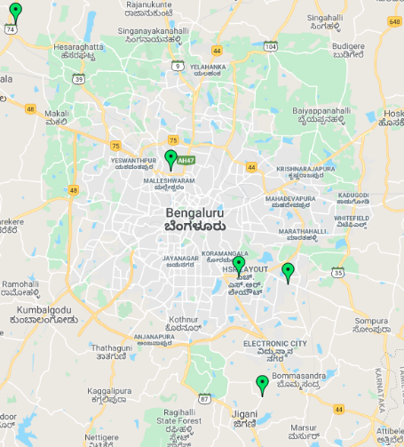
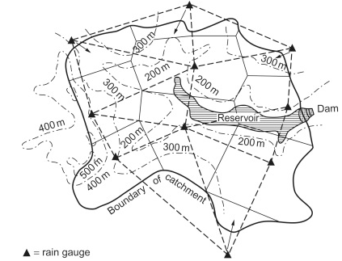
Research Methodology
a.Rainfall Estimation
Yuktix has gauges all over Bangalore. In order
to accurately measure the mean rainfall over an area of road, the Thiessan Polygon Method is used

Slide 9
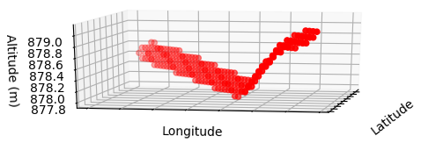
Research Methodology
b. Elevation score
The elevation score is a measure of how likely the road is to collect water
[6] used a 2D model to calculate an elevation score
In our work we attempt to use a 3D model instead
We use the volume of the convex hull corresponding to the points on the road, divided by the area of the rectangle which divides the road

Slide 10
Research Methodology
c. Sequential Model
In order to provide our model with the capability of being able to to represent non-linear relations, we use a simple neural network architecture.
2 hidden Layers
Input layer will have 5 neurons, and the input passed will contain the following values:
Elevation Score of Location
Previous Time Segment Precipitation
Previous Time Segment Traffic
Time Segment Index
Day of Week Index
The output of the network will be a one hot encoded vector denoting the severity of the predicted traffic in the next time segment

Slide 11
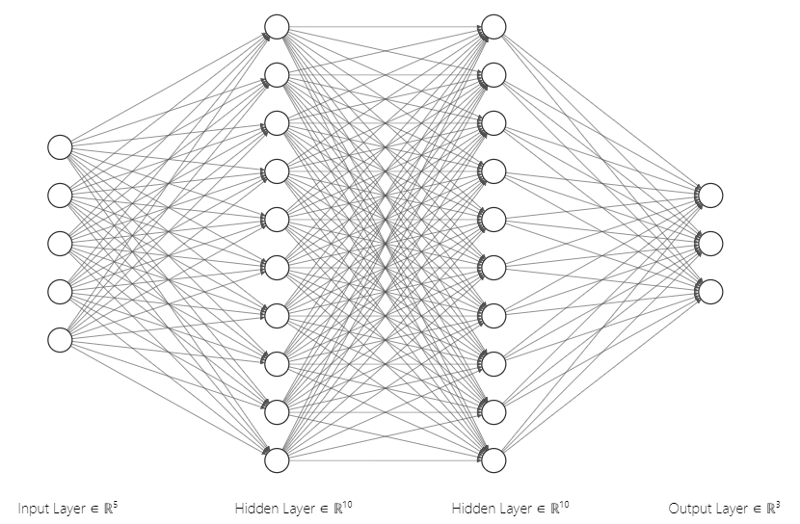
Dependencies and Risks
Model Architecture

Slide 12
Dependencies and Risks
Data Availability- precipitation,runoff,etc
Conflict with KSNDMC Project
Yuktix data extensiveness - Imputation required, more stations

Slide 13
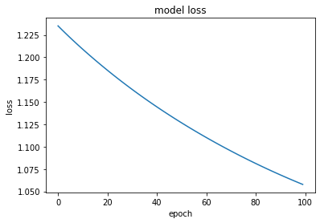
Results of Research Study & Demo
The model achieved an accuracy of 85.71%
The loss function is shown below:

Slide 14
Results of Research Study & Demo
In this work we propose a model for predicting the effect of rainfall on traffic within the next four hour window
This information can be used beforehand to help estimate traffic in an area and to hence make appropriate changes in plans for travel. We present an easy to use GUI for this task.

Slide 15
Challenges for Future Work
In the future the accuracy of our model can be increased by training with more data. Apart from simply increasing the number of data points used in training, using different sources may help as well. Runoff data, DEM vector data and drainage data may help a great deal.
It is also reasonable to believe that a deeper or more complex neural network architecture will perform better. However, such a network will require additional data.

Slide 16
Research Credits Actual Weekly Plan
Weeks | Activity
1 - 2 [19/08/19 - 30/08/19] | Selection of the problem statement, followed by a detailed literature survey on the existing work
3 - 5 [02/09/19 - 20/09/19] | Procurement of the various datasets involved, along with fine tuning of the algorithm that is going to be used
6 - 8 [30/09/19 - 18/09/19] | Development of the initial draft of the codebase
9 - 10 [21/09/19 - 01/10/19] | Completion and testing of the codebase
11 - 12 [11/10/19 - 22/10/19] | Report/Paper writing

Slide 17
Thank You

